Slide 1
Storm Data
An Exploratory Data Analysis Project
Amie Davis, amodavis@my365.bellevue.edu, DSC530, Bellevue University, 28 February 2020

Slide 2
Hypothesis
Storms are getting more intense.
Follow-on Questions :
Are storms getting more intense?
Are storms occurring more frequently?
Are storms getting larger in magnitude?
What is causing the storms?
Are storms causing more damage?

Slide 3


Data Source
National Oceanic and Atmospheric Administration’s (NOAA’s) National Weather Service (NWS)
https://www.ncdc.noaa.gov/stormevents/ftp.jsp

Slide 4
Variables Considered
Wind Speed
Measured extent of wind speeds in mph (e.g. 60 mph winds) of the weather event
Hail Size
Measured extent of hail size in inches (e.g. 0.75” of hail) of the weather event
Range
Distance to the nearest tenth of a mile, to the geographical center of the weather event
Property Damage
The estimated amount of damage to property incurred by the weather event.
Crop Damage
The estimated amount of damage to crops incurred by the weather event

Slide 5
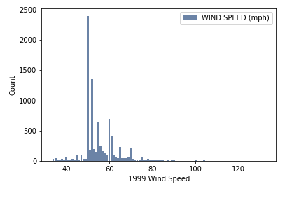
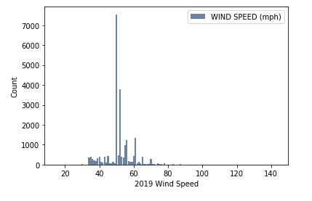
Wind Speed
1999
2019
Mean: 55.11 mph
Mode: 50 mph
Variance: 70.62
StdDev: 8.4
Mean: 51.54 mph
Mode: 50 mph
Variance: 58.56
StdDev: 7.65
No outliers. All values are feasible, up to 143 mph, which are Category Four hurricane-level winds.

Slide 6
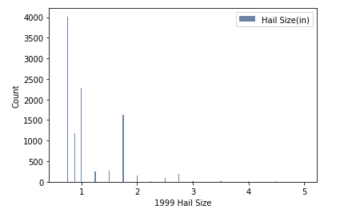
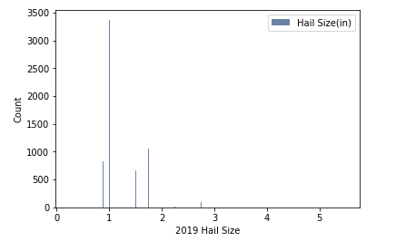
Hail Size
1999
2019
Mean: 1.11”
Mode: 0.75”
Variance: 0.27
StdDev: 0.52
Mean: 1.23”
Mode: 1”
Variance: 0.24
StdDev: 0.49
No outliers. All values are feasible (up to 5.5 inches). I've seen hail up to 3 inches in St.Louis.

Slide 7
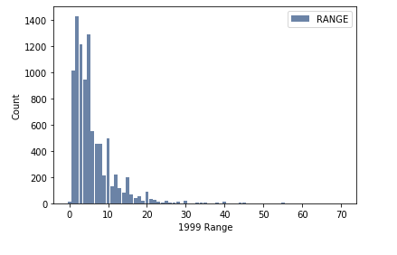
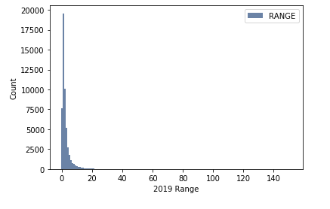
Range
1999
2019
Mean: 5.95 miles
Mode: 2 miles
Variance: 30.35
StdDev: 5.51
Mean: 3.0 miles
Mode: 1 mile
Variance: 25.65
StdDev: 5.06
No outliers. All values greater than zero are feasible (0 to 150 miles).
There are many range values missing in the 1999 dataset, which make it difficult to compare the two histograms.

Slide 8
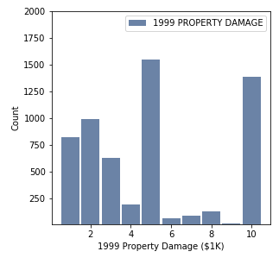
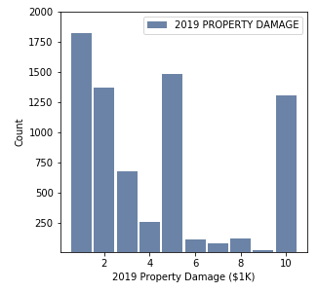
Property Damage
1999
2019
Due to the large range of dollar amounts, histograms are not the best way to view this data. The Probability Mass Function (PMF) presents a better picture.
Above are histograms representing the distribution between $0 and $10,000.

Slide 9
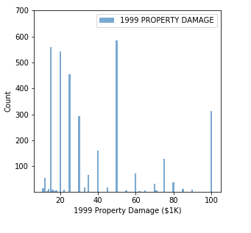
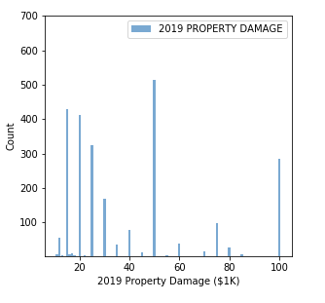
Property Damage (cont.)
1999
2019
Due to the large range of dollar amounts, histograms are not the best way to view this data. The Probability Mass Function (PMF) presents a better picture.
Above are histograms representing the distribution between $10,000 and $100,000.

Slide 10
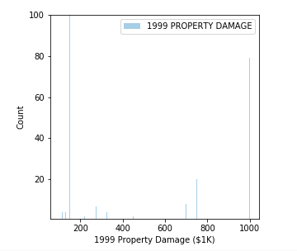
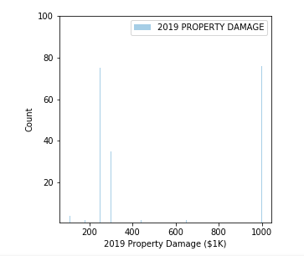
Property Damage (cont.)
1999
2019
Due to the large range of dollar amounts, histograms are not the best way to view this data. The Probability Mass Function (PMF) presents a better picture.
Above are histograms representing the distribution between $100,000 and $1,000,000.

Slide 11
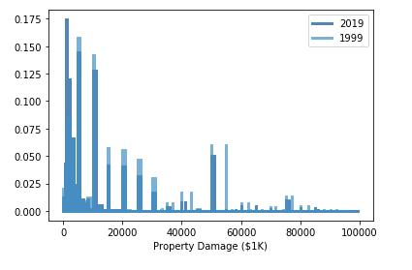
Property Damage (cont.)
PMF
1999
2019
Mean: $540.65K
Mode: $5K
Variance: 74101354.0
StdDev: 8608.21
Mean: $268.69K
Mode: $1K
Variance: 44775204.36
StdDev: 6691.43
Outliers: There is an extreme outlier of $3 billion dollars from 1999 which was removed from further analysis.
The large variance indicates the mode may be a better comparison than the mean.

Slide 12
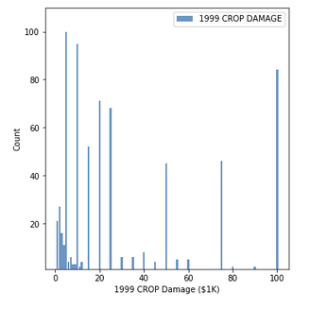
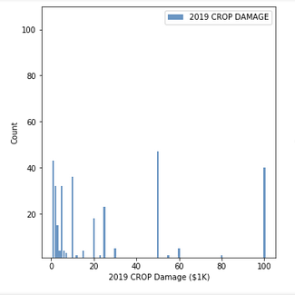
Crop Damage
1999
2019
Due to the large range of dollar amounts, histograms are not the best way to view this data. The Probability Mass Function (PMF) presents a better picture.
Above are histograms representing the distribution between $0 and $100,000.

Slide 13
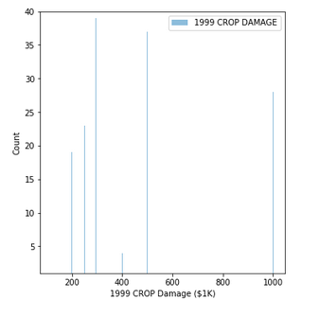
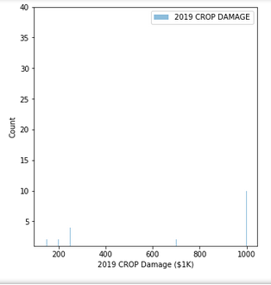
Crop Damage (cont.)
1999
2019
Due to the large range of dollar amounts, histograms are not the best way to view this data. The Probability Mass Function (PMF) presents a better picture.
Above are histograms representing the distribution between $100,000 and $1,000,000.

Slide 14
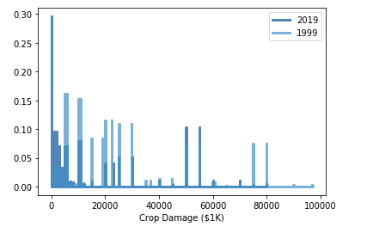
Crop Damage (cont.)
PMF
1999
2019
Mean: $3193.15K
Mode: $50K
Variance: 600362573.09
StdDev: 24502.3
Mean: $ 516.7K
Mode: $50K
Variance: 26719670.17
StdDev: 5169.11
No extreme outliers. All values in smallest and largest are feasible (10 to 500M).
The large variance indicates the mode may be a better comparison than the mean.

Slide 15
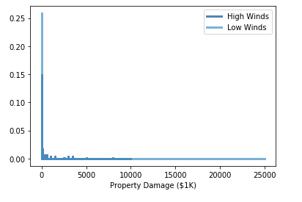
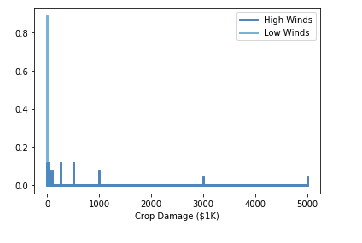
PMF Comparison Do High Winds Cause More Damage?
Property Damage
Crop Damage
Compares damage from storms with high winds to those with low winds
High winds defined as greater than 50mph (NWS)
Using 2019 dataset for comparison
Exclude outliers >= $100,000,000

Slide 16
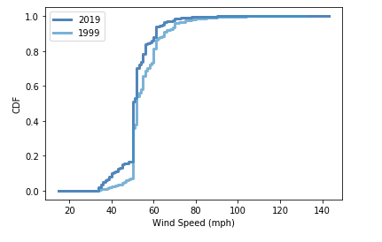
CDF – Wind Speed
The CDF plot for wind speed shows a sigmoid shape, representing a normal distribution. This is supported by the histograms.
This normal distribution identified wind speed as a good variable to focus on when measuring storms. Refining questions: Are winds causing more damage? Are winds becoming more intense?

Slide 17
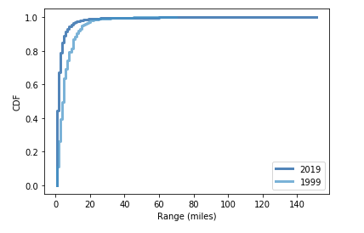
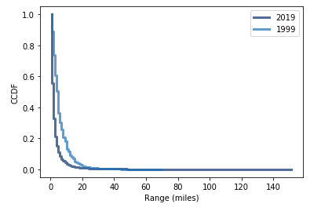
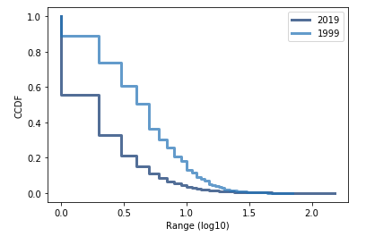
Pareto Distribution Analysis Range
The shape of the CDF plot appears to show an exponential or Pareto distribution.
The CCDF plot is not straight, so an exponential distribution is not represented.
The CCDF plot against the log(range) is fairly straight for the 1999 dataset and may be representative of a Pareto distribution.

Slide 18
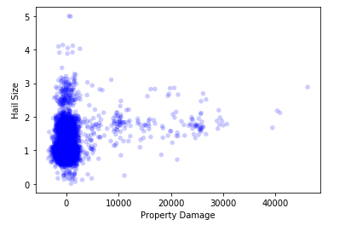
Correlations Property Damage vs. Hail Size
Covariance : 296.48
Correlation Coefficient: 0.215
A positive correlation
The correlation coefficient shows a medium effect
This is the largest relationship among variables in this dataset

Slide 19
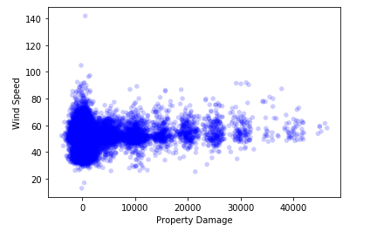
Correlations Property Damage vs. Wind Speed
Covariance : 4580.29
Correlation Coefficient: 0.117
A positive correlation
The correlation coefficient shows a small effect

Slide 20
Hypothesis Test
Null hypothesis:
Storms with high winds cause the same damage as all other storms.
Test statistic:
Difference in means of property damage storms with high winds and storms without high winds.
High winds defined as greater than 50mph (NWS)
Run tests with random subsets

Slide 21
Hypothesis Test (cont.)
Sample Size | P-value
22001 | 0.0
11000 | 0.0
5500 | 0.0
2750 | 0.0
1375 | 0.49
687 | 0.93
343 | 0.22
171 | 0.01
85 | 0.01
42 | 0.92
The results show that if we sample 2750 or more events, the effect (high winds impacting property damage) is statistically significant and unlikely to have occurred by chance, indicating the effect is likely to appear in the larger population.
Null hypothesis = False
Storms with high winds do not cause the same damage as all other storms.

Slide 22
Regression Analysis
Dependent Variable:
Property Damage
Explanatory Variables:
Range and Wind Speed
Variable | Coefficient | P-value
Range | -43.81 | 0.0
Wind Speed | 181.05 | 0.0
With the regression model built, we can predict property damage, given range and wind speed.
For example, we can predict the amount of property damage expected for a storm with 60 mph winds and a range of 1 mile.
Given these parameters, the model returns an expected property damage amount of $4,450.

Slide 23
Summary
Are storms getting more intense?
Wind speed has slightly decreased
Hail size has slightly increased
Are storms getting larger in magnitude?
Range has decreased ~ 50%
Are storms causing more damage?
Property damage has lowered
Crop damage remains similar
Do high winds cause more damage?
High winds caused more crop damage
High winds do not cause more property damage

Slide 24
Summary (cont.)
Distributions
Normal Distribution – Wind speed
Pareto Distribution – 1999 Range
Positive Correlations
Property Damage & Hail Size (medium)
Property Damage & Wind Speed (small)
Hypothesis Test Conclusion
Storms with high winds do not cause the same damage as all other storms.
Regression Model
Predict property damage, given range and wind speed.

Slide 25
References
Agarwal, R. (2019, July 21). Apply and Lambda usage in pandas. Retrieved from https://towardsdatascience.com/apply-and-lambda-usage-in-pandas-b13a1ea037f7.
Downey, A. (2014). Think Stats. Sebastopol, CA: OReilly Media.
National Centers for Environmental Information. (n.d.). Storm Events Database. Retrieved December 14, 2019, from https://www.ncdc.noaa.gov/stormevents/details.jsp.
pandas.DataFrame.join. (n.d.). Retrieved January 25, 2020, from https://pandas.pydata.org/pandas-docs/stable/reference/api/pandas.DataFrame.join.html
Saffir–Simpson scale. (2020, January 6). Retrieved from https://en.wikipedia.org/wiki/Saffir–Simpson_scale.
Wind. (2019, September 9). Retrieved February 1, 2020, from https://www.weather.gov/safety/wind

